Slide 1
Convolutional Neural Networks and Recurrent Neural Networks
Jian Tang
HEC Montreal
Mila-Quebec AI Institute
Email: jian.tang@hec.ca

Slide 2
Convolutional Neural Networks for Object Recognition

Slide 3
Computer Vision
Intuitions
Deal with very high-dimensional inputs: 150 x 150 pixels = 22500 inputs
Can exploit the 2D topology of pixels
Can build in invariance to certain variations, e.g., translation, etc.
Techniques
Local connectivity
Parameter sharing
Convolution
Pooling/subsampling hidden units

Slide 4
Deep Convolutional Neural Networks

Slide 5
Local Connectivity

Slide 6
Local Connectivity

Slide 7
Local Connectivity

Slide 8
Local Connectivity
Example: 200x200 image, 40k hidden units, filter size 10*10, ~4M parameters

Slide 9
Parameter Sharing

Slide 10
Parameter Sharing

Slide 11
Parameter Sharing

Slide 12

Discrete Convolution
$${\left(x∗k\right)}_{ij}=\sum_{pq}{x_{i+p, j+q}k_{r−p, r−q}}$$

Slide 13
Discrete Convolution
$${\left(x∗k\right)}_{ij}=\sum_{pq}{x_{i+p, j+q}k_{r−p, r−q}}$$

Slide 14
Discrete Convolution
$${\left(x∗k\right)}_{ij}=\sum_{pq}{x_{i+p, j+q}k_{r−p, r−q}}$$

Slide 15
Discrete Convolution
$${\left(x∗k\right)}_{ij}=\sum_{pq}{x_{i+p, j+q}k_{r−p, r−q}}$$

Slide 16
Discrete Convolution
$${\left(x∗k\right)}_{ij}=\sum_{pq}{x_{i+p, j+q}k_{r−p, r−q}}$$

Slide 17
Discrete Convolution
$${\left(x∗k\right)}_{ij}=\sum_{pq}{x_{i+p, j+q}k_{r−p, r−q}}$$

Slide 18

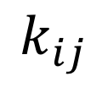
Example
$$(x_{i}∗k_{ij})$$
$$k_{ij}$$

Slide 19

Example
$$(x_{i}∗k_{ij})$$

Slide 20
Example

Slide 21
Example

Slide 22
Multiple Feature Maps

Slide 23
Pooling
Pool hidden units in same neighborhood
Pooling is performed in non-overlapped neighborhoods (subsampling)

Slide 24
Pooling

Slide 25
Example: Pooling

Slide 26
Translation Invariance

Slide 27
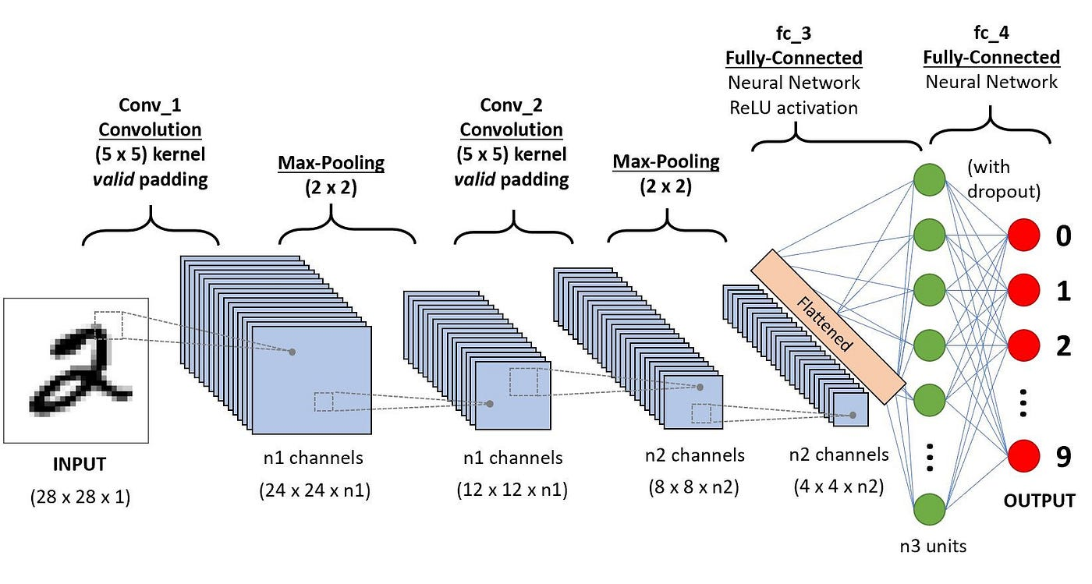
Convolutional Neural Network

Slide 28
Convolutional Neural Network

Slide 29
Invariance by Dataset Expansion

Slide 30
ImageNet Dataset

Slide 31
Important Breakthroughs

Slide 32
How to Select the Right Architecture?
From manual tuning features => manual tuning architectures
Many hyper-parameters
Number of layers (depth), number of feature maps (width)
Grid search (need lots of GPUs)
Smarter Strategies
Random search
Bayesian optimization
Reinforcement Learning (Zoph et al. 2016)

Slide 33
AlexNet

Slide 34
AlexNet

Slide 35
AlexNet

Slide 36
GoogLeNet

Slide 37
Deep Residual Networks (He et al. 2016)
Very deep convents do not train well
ResNet: introduce “pass through” into each layer
Thus only residual now needs to be learned.

Slide 38
Selecting the Architecture

Slide 39
Optimization Tricks and Improving Generalization
Adam, Batch-normalization, and dropout works very well
Use ReLU nonlinearity
Weight Sharing
Data Augmentation
Weight Decay (L1, L2)
Unsupervised Pretraining
Multi-task Learning

Slide 40
Pytorch Tutorial on Convolutional Neural Networks
https://pytorch.org/tutorials/beginner/blitz/cifar10_tutorial.html

Slide 41
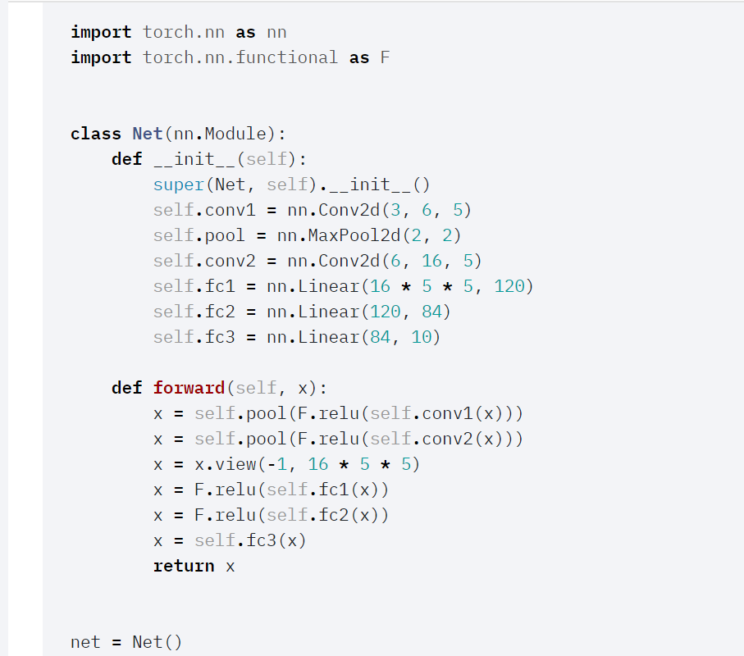

Slide 42
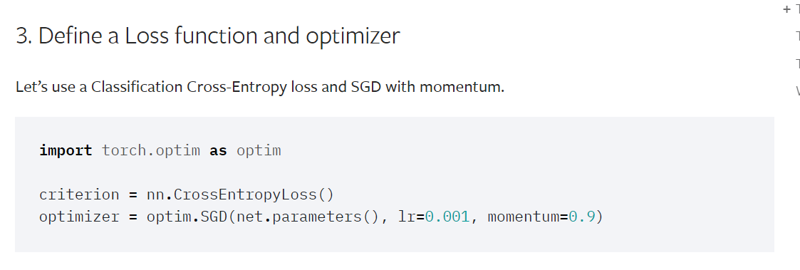

Slide 43
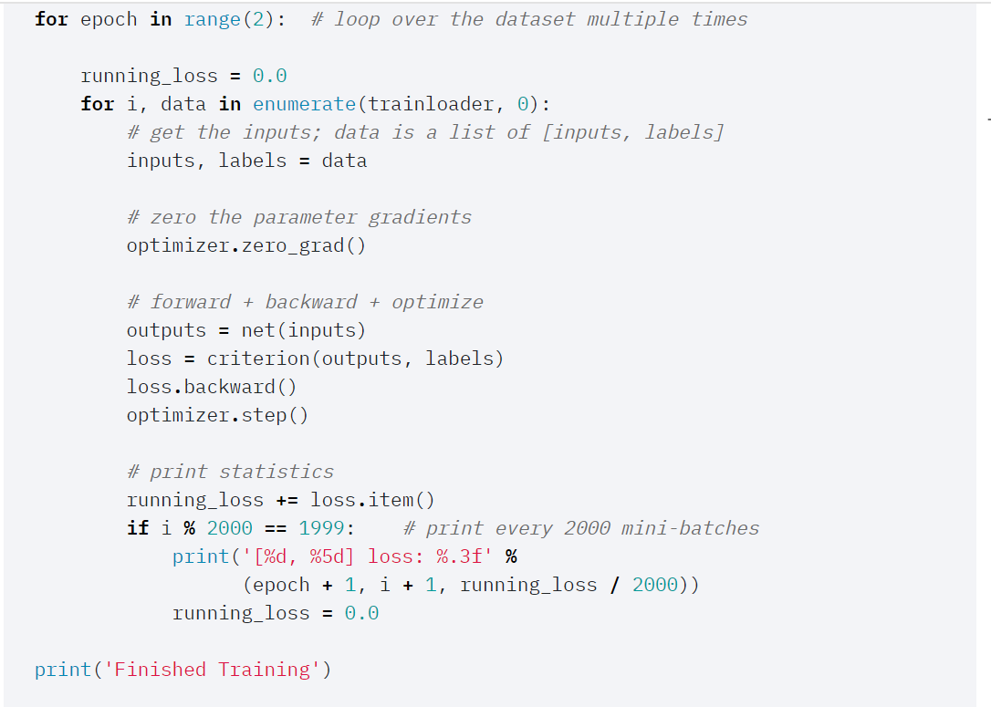

Slide 44
Recurrent Neural Networks

Slide 45
RNN: Recurrent neural networks
Neural networks for sequence modeling
Summarize a sequence with fix-sized vector through recursively updating
h

Slide 46
Recurrent Neural Networks
Can produce an output at each time step: unfolding the graph tell us
how to back-prop through time

Slide 47
Recurrent Neural Networks
Produce a single output at the end of sequence

Slide 48
Language Modeling

Slide 49

RNN for Language Modeling
Estimate the probability of a sequence
$$tanh$$

Slide 50

RNN for Language Modeling
$$tanh$$
is the embedding of the word at time step t.

Slide 51
RNN for Language Modeling

Slide 52
RNN for Language Modeling

Slide 53
Training RNN is very Hard

Slide 54
Gradient Vanishing/Exploding

Slide 55
Long-short Term Memory (LSTM)
From multiplication to summation
Forget gate (forget past)

Slide 56
Deep Bidirectional RNN (Irsoy and Cardie)

Slide 57
Sequence Models and LSTM in Pytorch
https://pytorch.org/tutorials/beginner/nlp/sequence_models_tutorial.html

Slide 58
Inputs
Pytorch’s LSTM expects all of its inputs to be 3D tensors.
The first axis is the sequence itself,
the second indexes instances in the mini-batch,
the third indexes elements of the input.

Slide 59
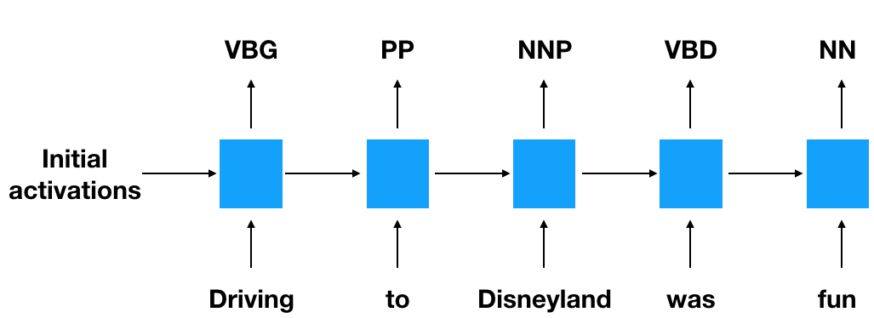
An LSTM for Part-of-Speech Tagging

Slide 60
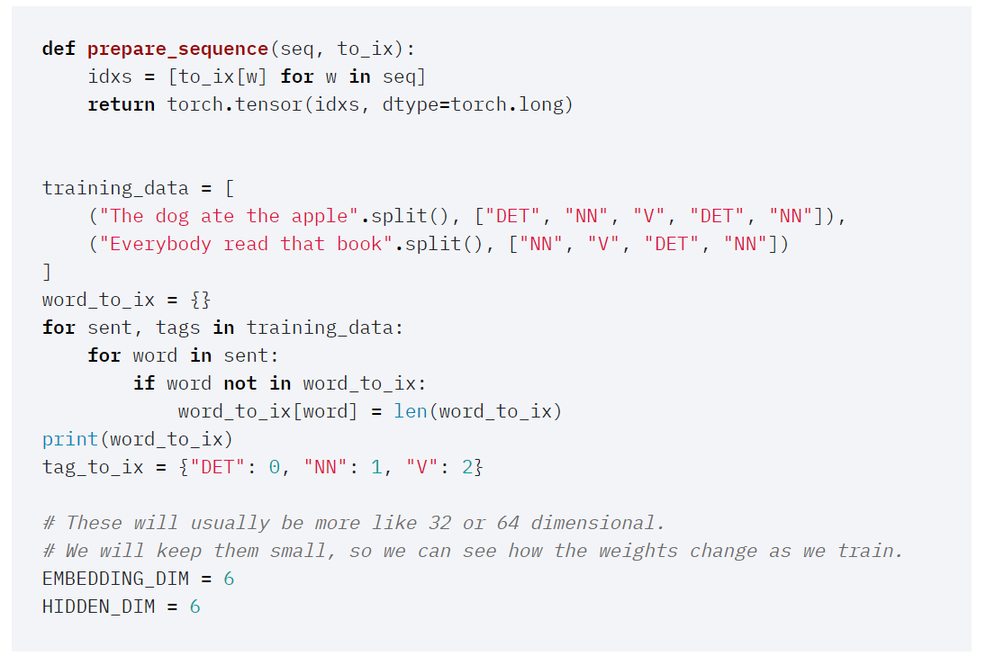

Slide 61
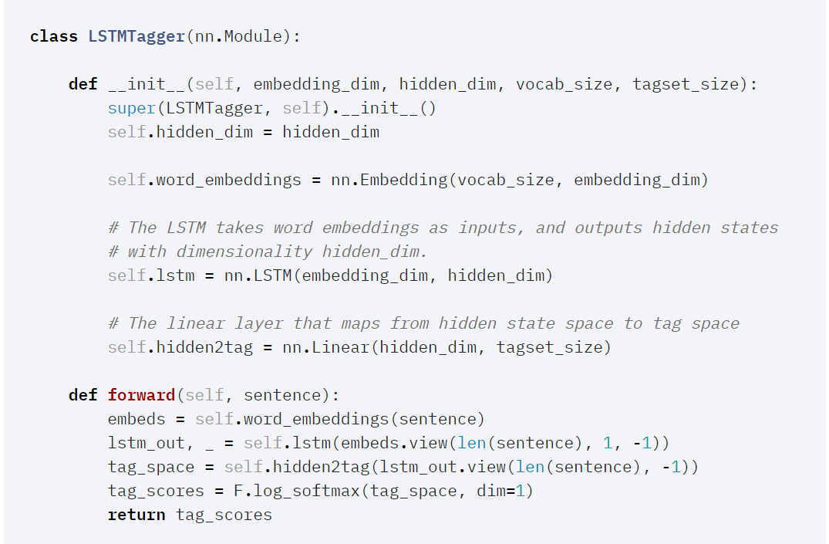

Slide 62
Language Model with LSTM in Pytorch
https://github.com/pytorch/examples/tree/master/word_language_model

Slide 63
Readings
Deep Learning Book, Chap 9&10.

Slide 64
Details

Slide 65
Details

Slide 66
Details

Slide 67
Details

Slide 68
Discrete Convolution

